Slide 1

Creativity in K12 Education
Laura Feeney | Education Advocate | lafeeney@adobe.com | @lauramfeeney
Matt Cauthron | Teacher | Digital Arts Technology Academy | mcauthron@psusd.us

Slide 2
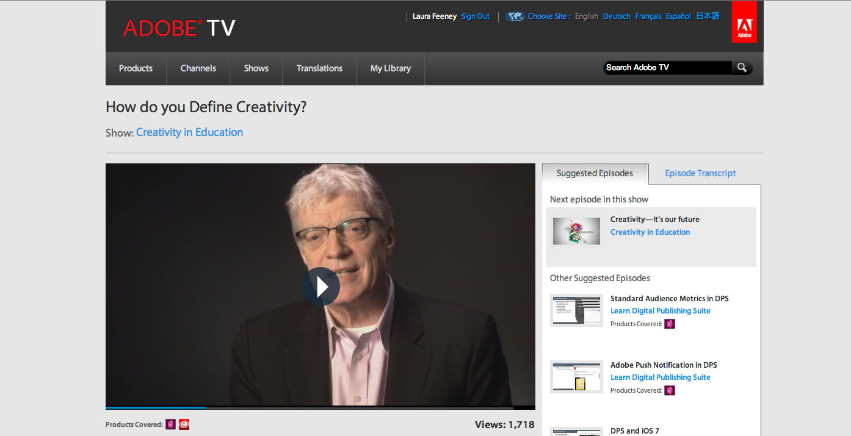
Creativity: What is it?
http://tv.adobe.com/watch/creativity-in-education/how-do-you-define-creativity/
Notes:
http://tv.adobe.com/watch/creativity-in-education/how-do-you-define-creativity/

Slide 4
Objectives
Learn about research on the value of creativity in education.
Hear examples of creativity in classrooms.
Consider how you can work to integrate creativity into your context

Slide 5
85%
agree creative thinking is critical for problem solving in their career
32%
don’t feel comfortable thinking creatively in their career
78%
wish they had more creative ability
Notes:
Source: Adobe Creativity and Education: Why it Matters Study
Study based on interviews with 1,000 U.S., college-educated and full-time salaried employees ages 25+
http://www.adobe.com/aboutadobe/pressroom/pdfs/Adobe_Creativity_and_Education_Why_It_Matters_study.pdf

Slide 6
71%
of college-educated professionals say creative thinking should be a taught as a course, like math and science
Interestingly, math and science ranked nearly as high as traditional creative subjects in contributing to creative thinking
ART
MUSIC
DRAMA
SCIENCE
MATH
Notes:
Source: Adobe Creativity and Education: Why it Matters Study
Study based on interviews with 1,000 U.S., college-educated and full-time salaried employees ages 25+
http://www.adobe.com/aboutadobe/pressroom/pdfs/Adobe_Creativity_and_Education_Why_It_Matters_study.pdf

Slide 7

78% say creativity is very important to their career
But only 57% thought so when they were in college
Notes:
Source: Adobe Creativity and Education: Why it Matters Study
Study based on interviews with 1,000 U.S., college-educated and full-time salaried employees ages 25+
http://www.adobe.com/aboutadobe/pressroom/pdfs/Adobe_Creativity_and_Education_Why_It_Matters_study.pdf

Slide 8

Of Education Majors:
86%
but only
68%
75%
48%
say creativity is something that you are born with and also something you can learn
viewed creativity as important in school
say it is important in their career
believe it currently has a place in their career
Notes:
Source: Adobe Creativity and Education: Why it Matters Study
Study based on interviews with 1,000 U.S., college-educated and full-time salaried employees ages 25+
http://www.adobe.com/aboutadobe/pressroom/pdfs/Adobe_Creativity_and_Education_Why_It_Matters_study.pdf

Slide 9
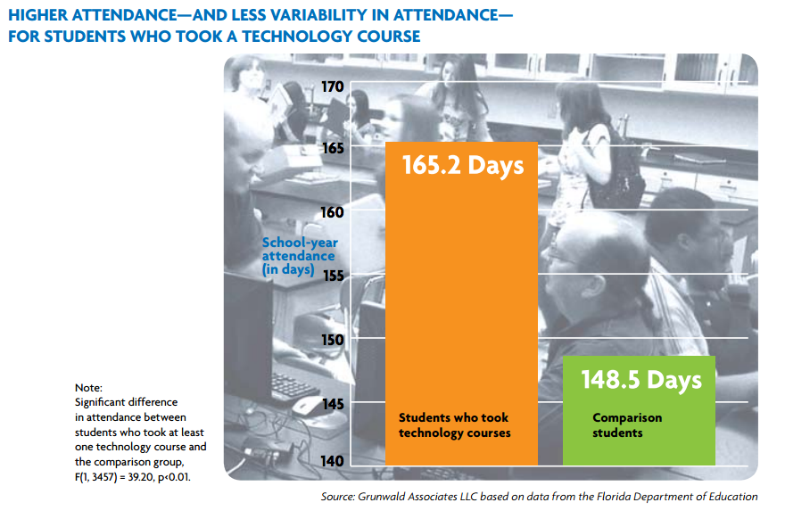

Slide 10
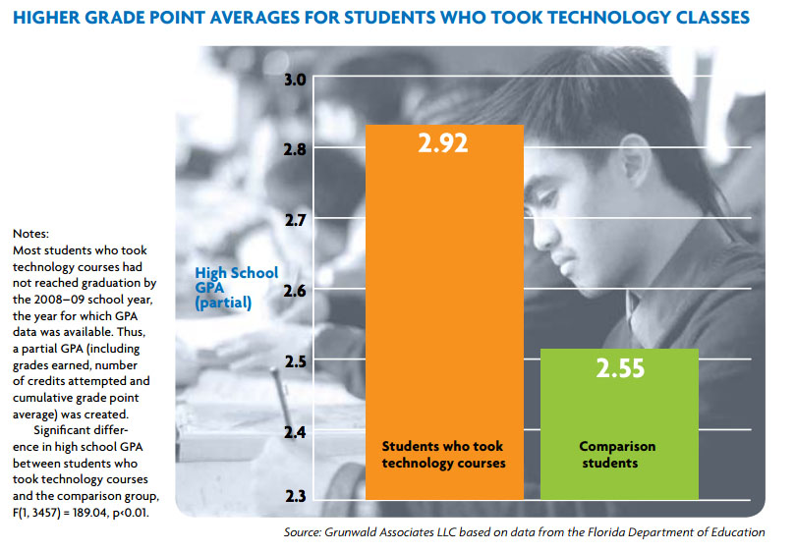

Slide 11
How is creativity important in your job?
In your career?

Slide 12

West Adams Preparatory High School
Los Angeles, California

Slide 13
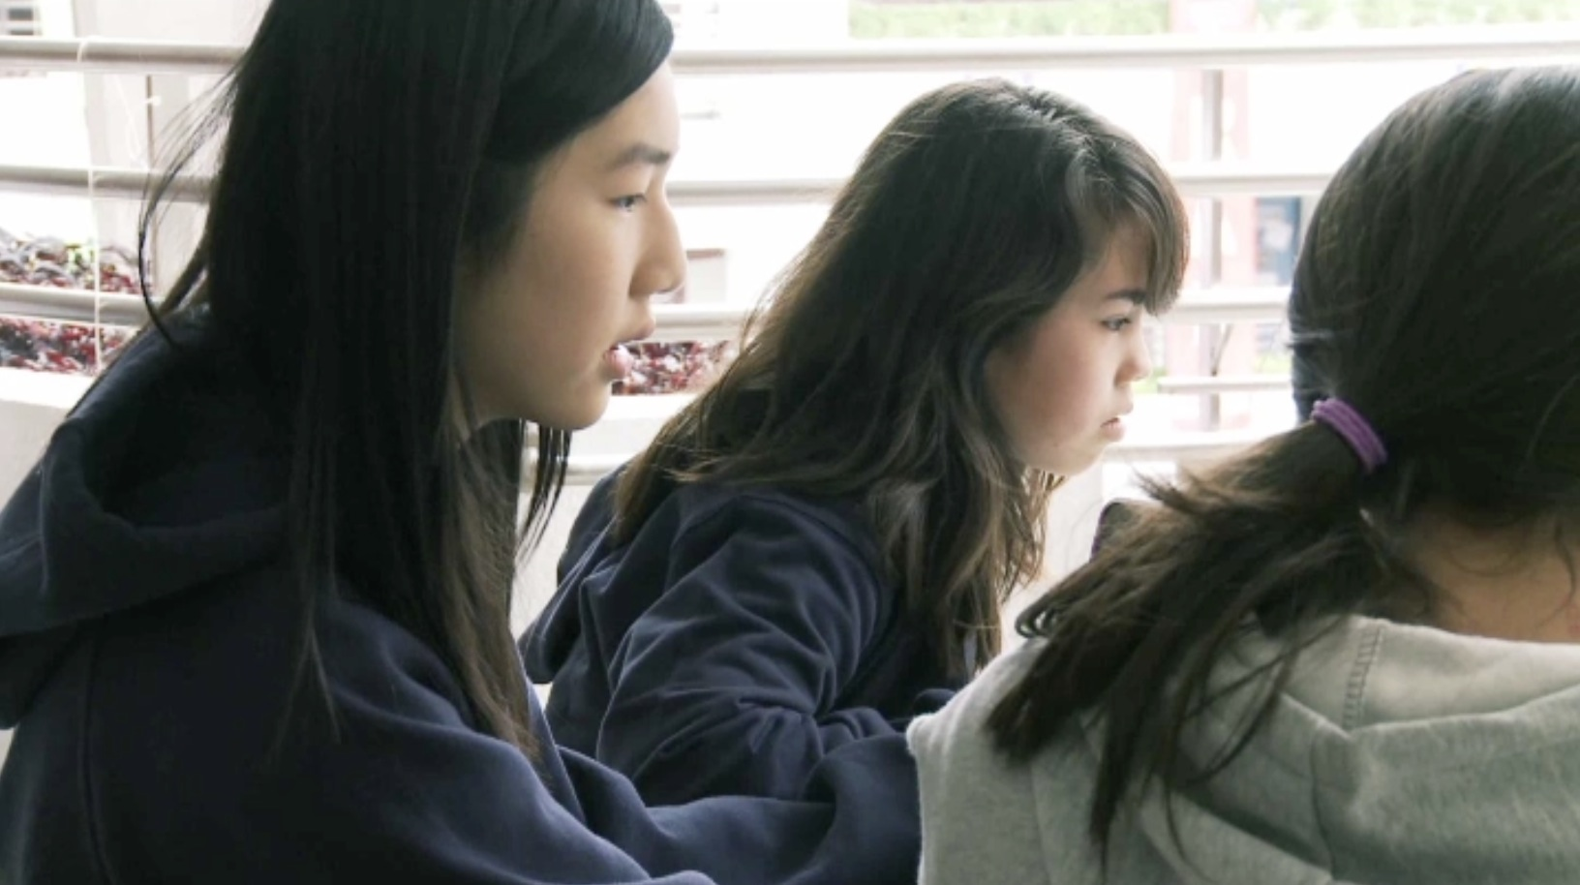
Producing more of the same knowledge and skills will not suffice to address the challenges of the future…Schools have to prepare students for jobs that have not yet been created, technologies that have not yet been invented and problems that we don't yet know will arise.
Andreas Schliecher, OECD Education Directorate

Slide 14
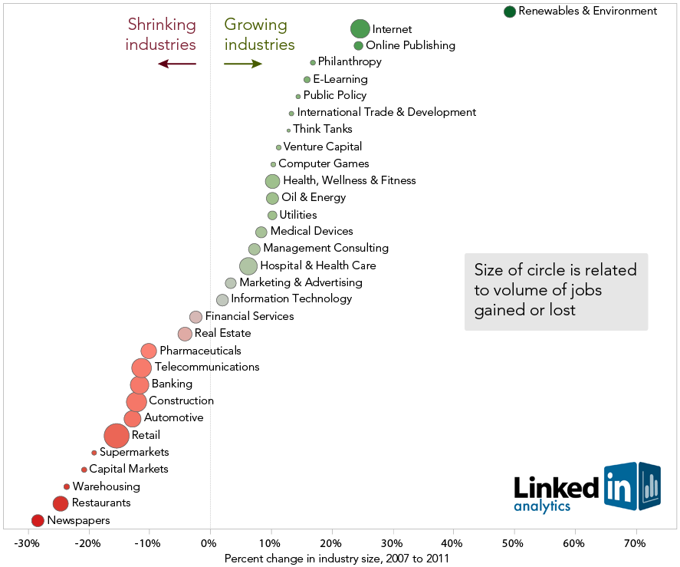

Slide 15


Five Skills Everyone Needs on a Resume
Excel
Web development
Adobe Creative Suite
Foreign language
Google Analytics
U.S. News & World Report, March 2012
Notes:
Slide purpose: Use objective sources to underscore industry demand.
Speaker notes:
Adobe software provides students with proven, unmatched, industry-standard tools that will help them acquire the communication skills sought by a wide range of industries
Proof Points:
http://money.usnews.com/money/blogs/outside-voices-careers/2012/03/20/5-skills-everyone-needs-to-have-on-a-resume

Slide 16
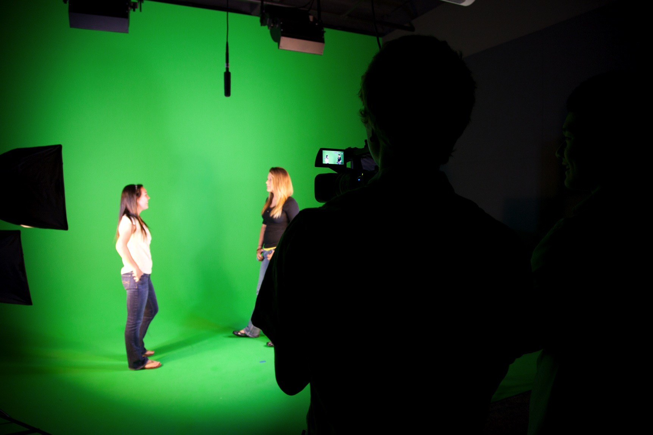
Presentation High School, San Jose, California

Slide 17
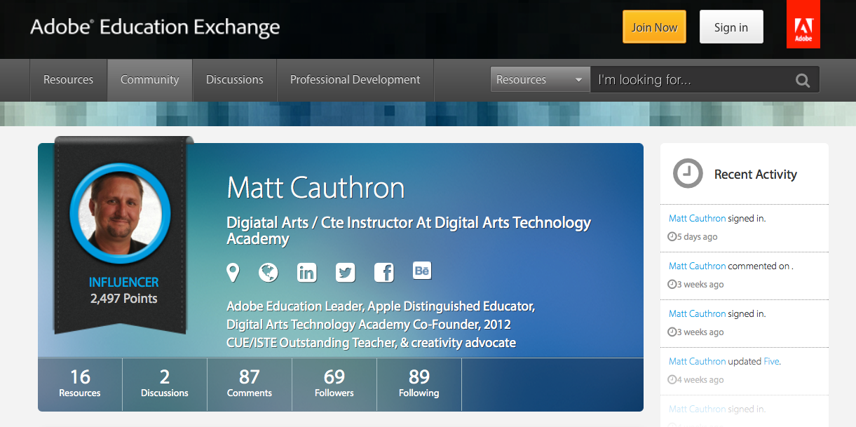
Connect!
17
Notes:
http://tv.adobe.com/watch/creativity-in-education/how-do-you-define-creativity/

Slide 18
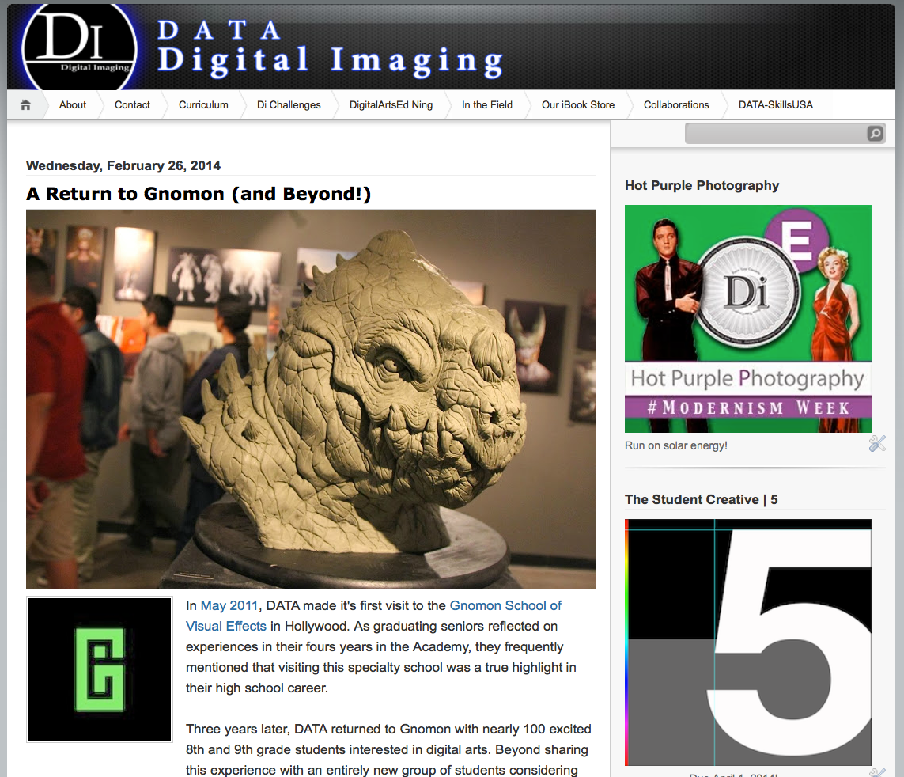
www.DATA-di.us
18
Notes:
http://tv.adobe.com/watch/creativity-in-education/how-do-you-define-creativity/

Slide 19

www.DATA-di.us
19
Notes:
http://tv.adobe.com/watch/creativity-in-education/how-do-you-define-creativity/

Slide 20
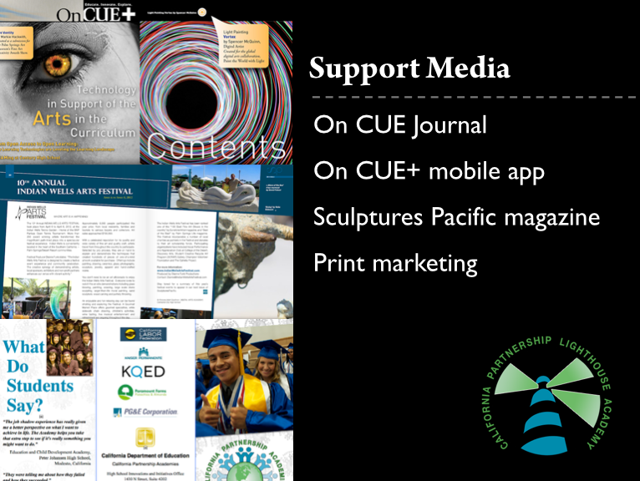
www.DATA-di.us
20
Notes:
http://tv.adobe.com/watch/creativity-in-education/how-do-you-define-creativity/

Slide 21
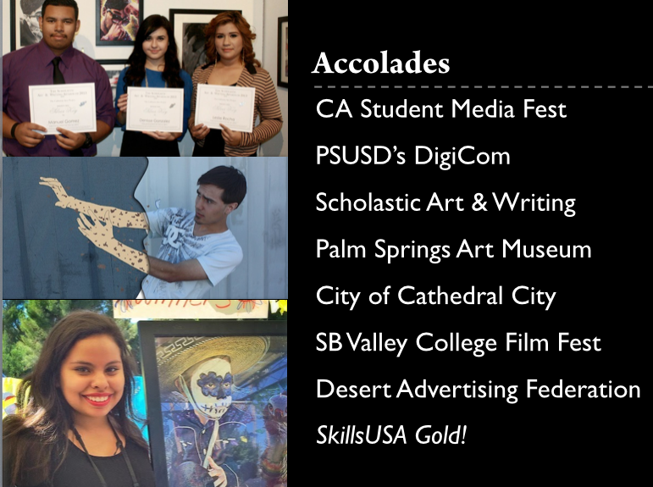
www.DATA-di.us
21
Notes:
http://tv.adobe.com/watch/creativity-in-education/how-do-you-define-creativity/

Slide 22

www.DATA-di.us
22
Notes:
http://tv.adobe.com/watch/creativity-in-education/how-do-you-define-creativity/

Slide 23
How can you work to integrate creativity into your classroom, curriculum, school, or district?

Slide 24
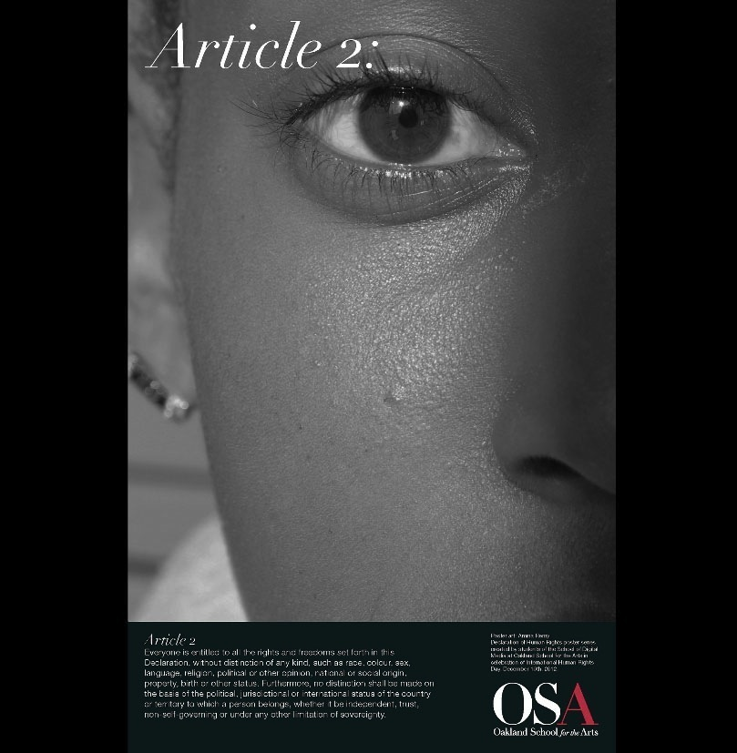
http://digitalmedia.oakarts.org
Notes:
http://www.flickr.com/photos/59183324@N08/sets/72157632086950002/show/

Slide 25
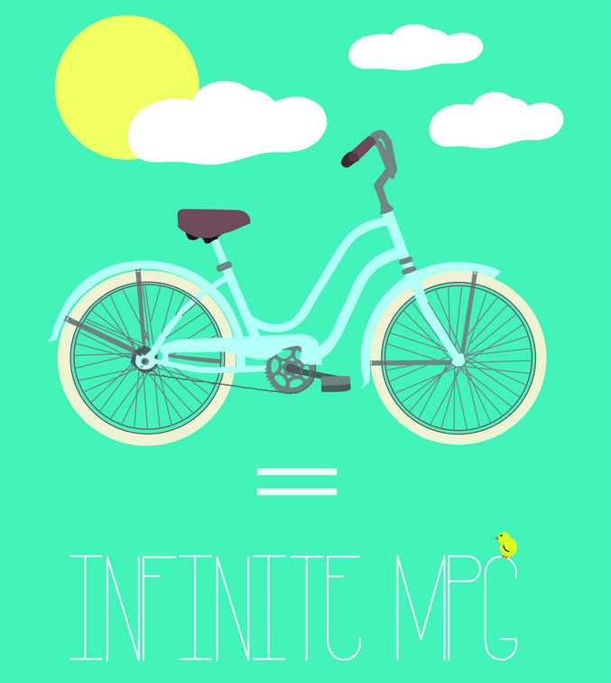
http://youthvoices.adobe.com/awards/
Notes:
http://youthvoices.adobe.com/awards/

Slide 26

http://youthvoices.adobe.com/awards/
Notes:
http://youthvoices.adobe.com/awards/

Slide 27
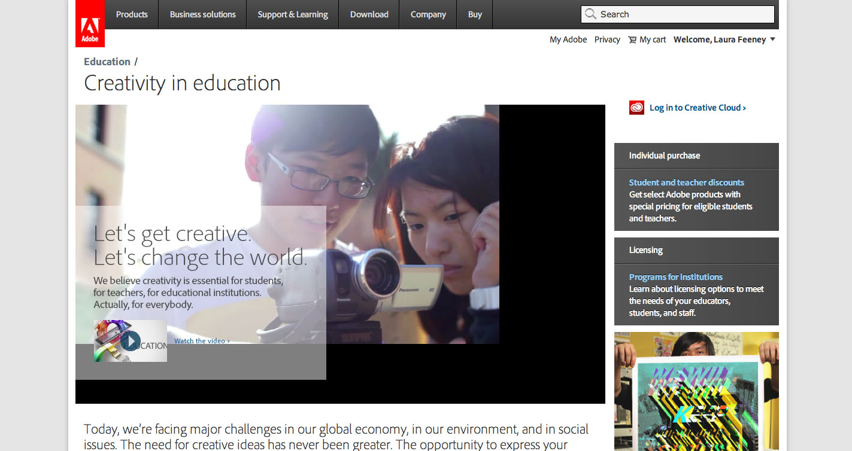
Resources: Adobe Education Creativity
http://www.adobe.com/education/creativity-in-education

Slide 28

Resources: Adobe Education Exchange
edex.adobe.com

Slide 29

If we teach today as we taught yesterday, we rob our children of tomorrow.
John Dewey

Slide 30


Closing
lafeeney@adobe.com
@lauramfeeney
http://feeneyandwest.wordpress.com/
Questions?
Laura Feeney
lafeeney@adobe.com
@lauramfeeney
Matt Cauthron
mcauthron@psusd.us

